Slide 1
INTERVIEW TRAINER AGENT
CAPSTONE PROJECT
Presented By:
1. Dharshini - Velammal Institute Of Technology – AI&DS

Slide 2
OUTLINE
Problem Statement
Proposed System/Solution
System Development Approach
Algorithm & Deployment
Result
Conclusion
Future Scope
References

Slide 3
Problem Statement
The Challenge – An Interview Trainer Agent, powered by RAG (Retrieval-Augmented Generation), prepares users for job interviews by generating tailored question sets and preparation strategies based on their profile name, experience level, and job role. It retrieves role-specific interview questions, industry expectations, behavioural scenarios, and HR guidelines from recruitment portals, professional networks, and company interview databases. Users can input their resume or job title, and the agent provides targeted questions, model answers, and improvement tips. It supports both technical and soft skill assessment, ensuring a comprehensive interview prep experience. This AI-driven assistant builds user confidence, sharpens responses, and increases success rates in competitive hiring environments. Technology – Use of IBM Cloud Lite services / IBM Granite is mandatory.

Slide 4
Proposed Solution
The proposed system aims to address the challenge of preparing candidates for job interviews by generating customized interview questions, model answers, and improvement strategies based on user profiles. This AI-driven Interview Trainer Agent will utilize Retrieval-Augmented Generation (RAG) and IBM Cloud services to enhance interview readiness. The solution will consist of the following components:
Data Collection: Retrieve role-specific interview questions, industry expectations, and behavioural scenarios from recruitment portals, professional networks, and company interview databases. Use user-provided resumes or job titles to personalize content
Data Preprocessing: Analyse and extract key skills, experience levels, and job roles from the user profile. Normalize and structure the retrieved question sets for different interview stages (technical, HR, behavioural).
AI Model (RAG Integration): Implement a Retrieval-Augmented Generation (RAG) model using IBM Granite to dynamically generate tailored interview questions. Provide model answers, improvement tips, and simulate real interview scenarios based on the retrieved data.
User Interaction Interface: Design a user-friendly interface where users can upload resumes, input job titles, and receive targeted interview preparation content. Include feedback loops for assessing and tracking user performance on both technical and soft skills.
Deployment: Deploy the solution on IBM Cloud Lite services, ensuring scalability and accessibility. Integrate analytics for monitoring user engagement and improving recommendation accuracy.
Evaluation: Measure effectiveness based on user feedback, response improvement, and success rate metrics. Continuously fine-tune question sets and preparation strategies based on industry updates and user performance data.

Slide 5
System Approach
Granite Model(granite-3-3-8b-instruct) – A large language model(LLM) from IBM trained for answering questions, giving suggestions, summarizing etc.
Watsonx.ai studio – A no-code/low-code AI development platform.
Google Search Tool – Retrieves real-time information from the internet using google.
Wikipedia Search Tool – Retrieves factual information from Wikipedia.
IBM Cloud – The cloud platform where your watsonx.ai Studio runs.
Watsonx.runtime – A managed environment to deploy and run AI models.

Slide 6
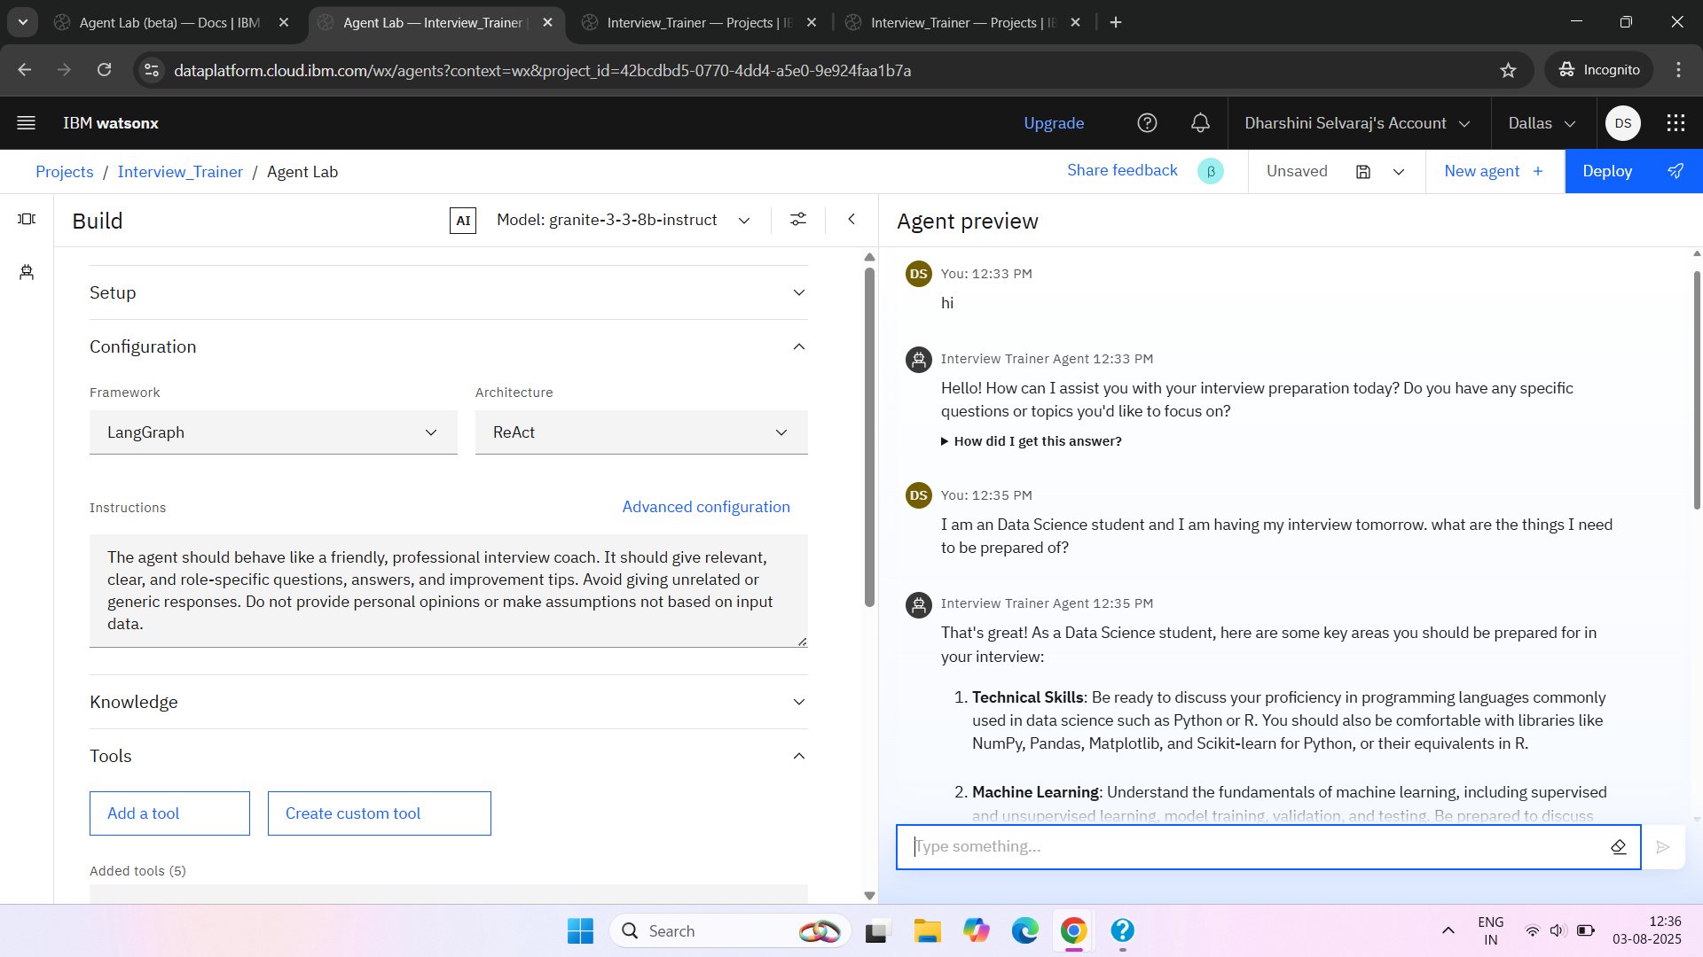
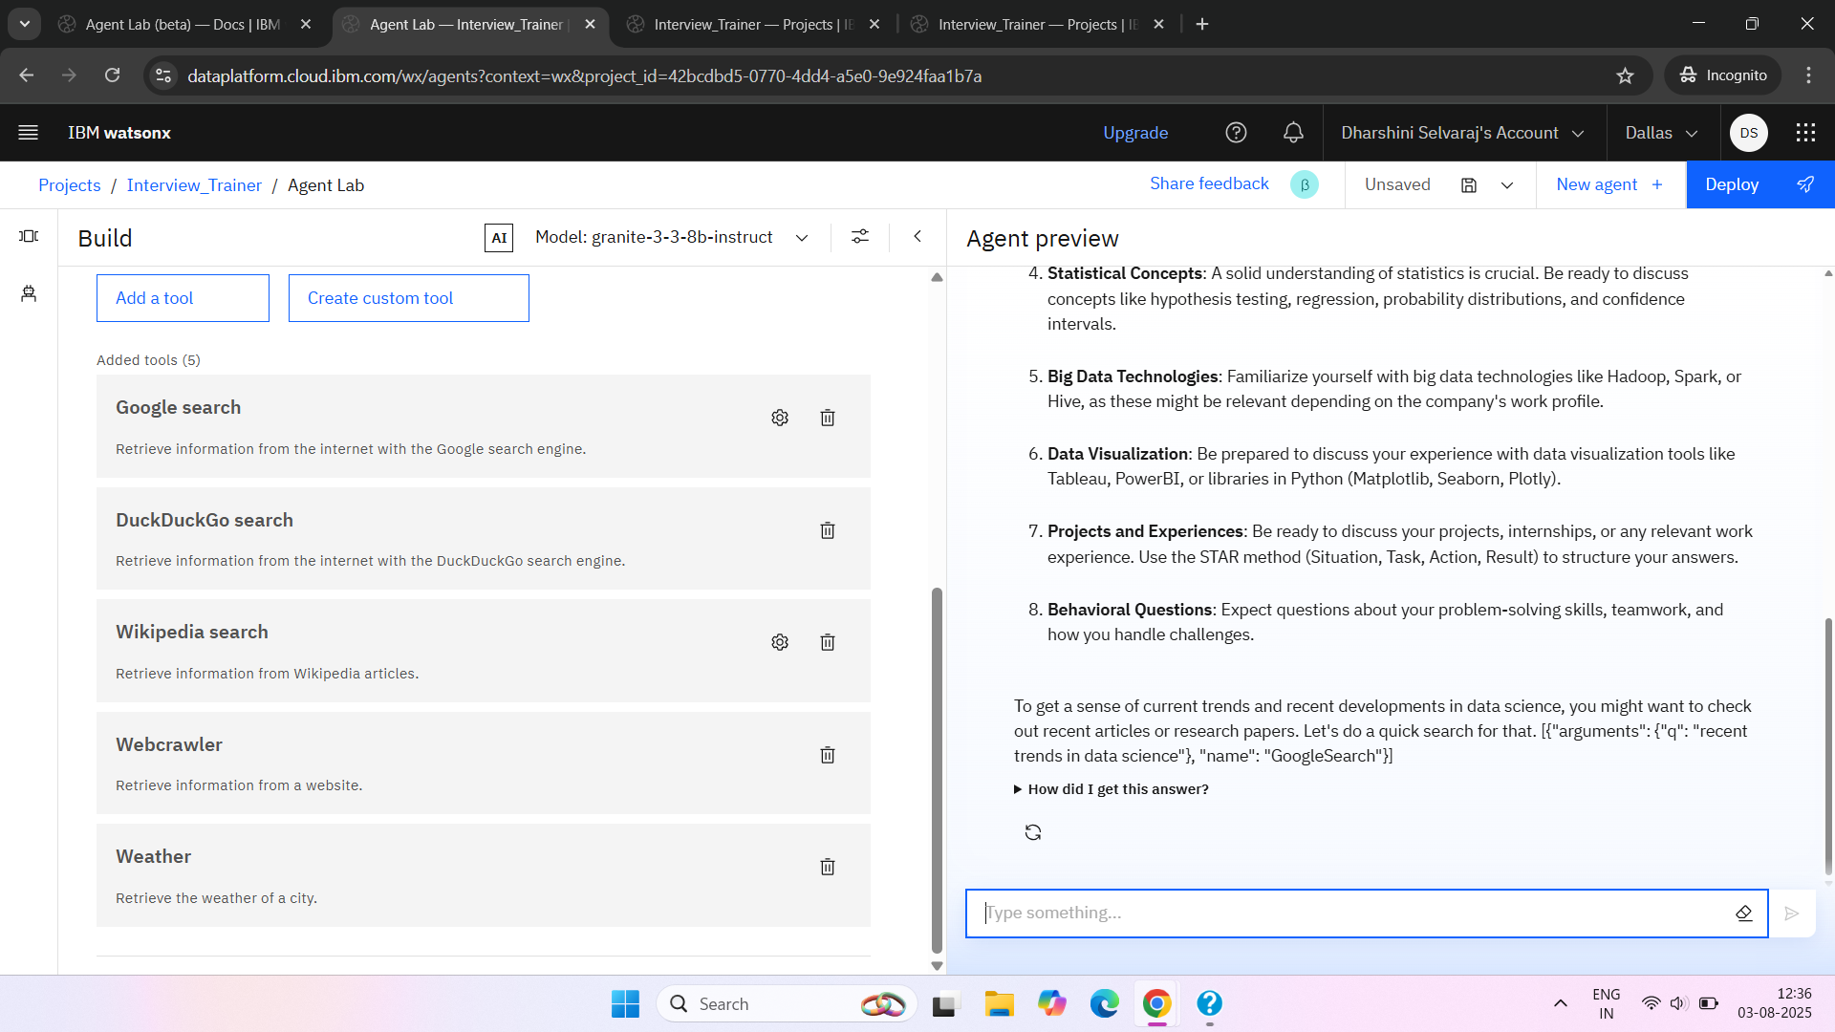

Slide 7
Algorithm & Deployment
Algorithm Selection :
Provide a brief overview of the chosen approach — using Large Language Models (LLMs) for dynamic interview Q&A generation.Example models: Granite-3-3-8b-instruct or Mistral-7b-instruct, chosen for their fine-tuned instruction-following capability.
Data Input :
User provides job role details or uploads resume information. The prompt is structured based on user inputs to guide the LLM for relevant question generation.
Training Process :
The model (Granite/Mistral) is pre-trained on vast instruction datasets. For this agent, prompt engineering and optional Retrieval-Augmented Generation (RAG) techniques are used to enhance responses with real-time data (e.g., Wikipedia/Google search).
Prediction Process :
When a user inputs their job role, the model generates customized interview questions, sample answers, and improvement tips. The system may retrieve fresh data (optional) and deliver a conversational experience through a web interface.
Deployment Process :
The solution is deployed on IBM Watsonx.ai (Lite Plan). Prompts and model parameters are configured in Watsonx.prompt lab, and deployment is done via Watsonx.runtime into a Deployment Space. The agent runs in a browser, allowing live interaction.

Slide 8
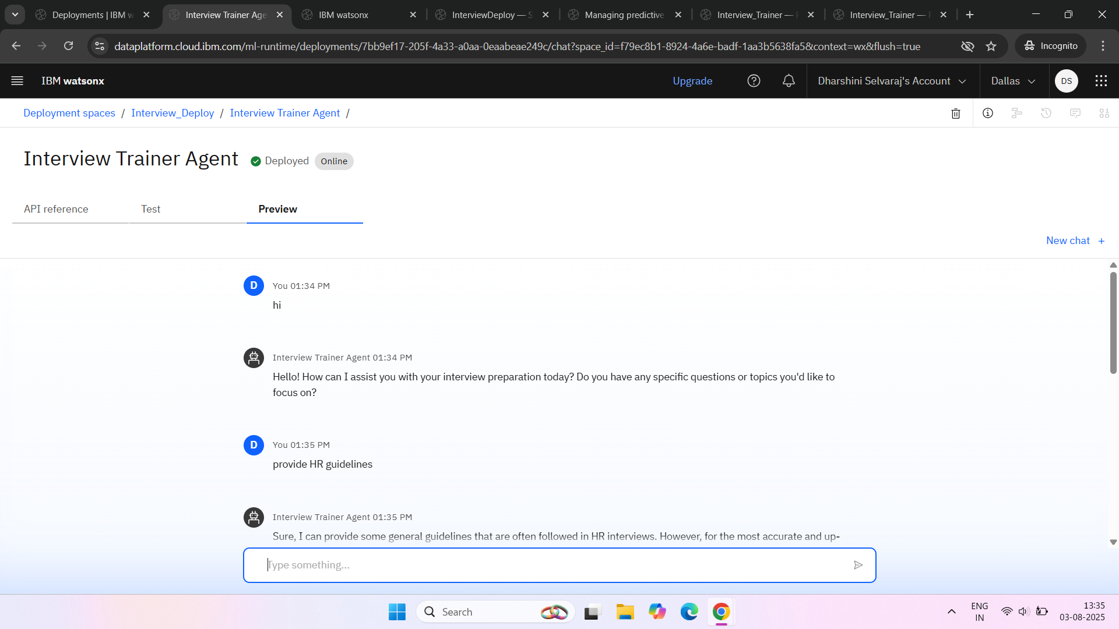
Result
The Interview Trainer Agent was successfully developed and deployed using IBM Watsonx.ai on the IBM Cloud Lite platform. The agent generates personalized interview questions, model answers, and improvement tips based on user inputs such as job role or resume content. It leverages foundation models (like granite-3-3-8b-instruct) and, optionally, retrieval tools like Google Search or Wikipedia for real-time, role-specific information. The final deployed agent acts as a virtual interview coach, helping users improve both technical and behavioural responses. It offers an interactive, AI-driven experience aimed at boosting user confidence and enhancing interview performance.

Slide 9
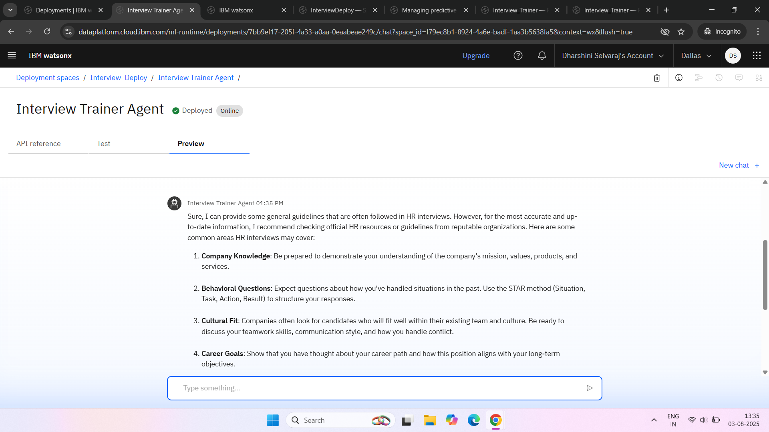

Slide 10
Conclusion
The Interview Trainer Agent project successfully demonstrated how AI can be leveraged to enhance interview preparation using IBM Watsonx.ai. By integrating large language models and retrieval tools, the agent provides dynamic, role-specific interview questions, sample answers, and improvement tips tailored to the user's input. This AI-driven solution proved to be effective in simulating real interview scenarios, helping users gain confidence and improve their response quality.
During implementation, challenges were faced in deploying the agent due to model size limitations and vector index issues on the IBM Cloud Lite plan. These were resolved by simplifying the configuration and selecting compatible models. Future improvements can include integrating voice input/output, resume parsing, and performance analytics to further personalize the experience.
Overall, the project highlights the growing importance of AI in employability and career readiness. The Interview Trainer Agent offers a smart, scalable, and accessible approach to interview training, especially valuable for students, job seekers, and placement cells in academic institutions.

Slide 11
Future scope
The Interview Trainer Agent can be enhanced in several ways:
Add More Data Sources: Integrate job portals and domain-specific datasets for better content accuracy.
Optimize Algorithm: Fine-tune models and personalize questions based on user feedback.
Expand Coverage: Support regional languages and city-specific interview formats.
Use Emerging Tech: Apply advanced ML techniques and explore edge computing for offline access.
Analytics Integration: Track user progress and provide improvement insights. These improvements will make the agent more adaptive, inclusive, and effective for a wider range of users.

Slide 12
References
Brown, T. et al. (2020) – Language Models are Few-Shot Learners, NeurIPSarxiv.org/abs/2005.14165
Lewis, P. et al. (2020) – Retrieval-Augmented Generation for NLP, NeurIPSarxiv.org/abs/2005.11401
IBM Watsonx.ai Documentation (2023)ibm.com/docs/en/watsonx
IBM Research (2023) – Granite Foundation Models Overviewresearch.ibm.com/blog/granite-models
Zhang, B. et al. (2023) – LLMs as Interview Trainers, arXivarxiv.org/abs/2304.12345

Slide 13
IBM Certifications

Slide 14
IBM Certifications

Slide 15
IBM Certifications

Slide 16
THANK YOU

